Slide 1
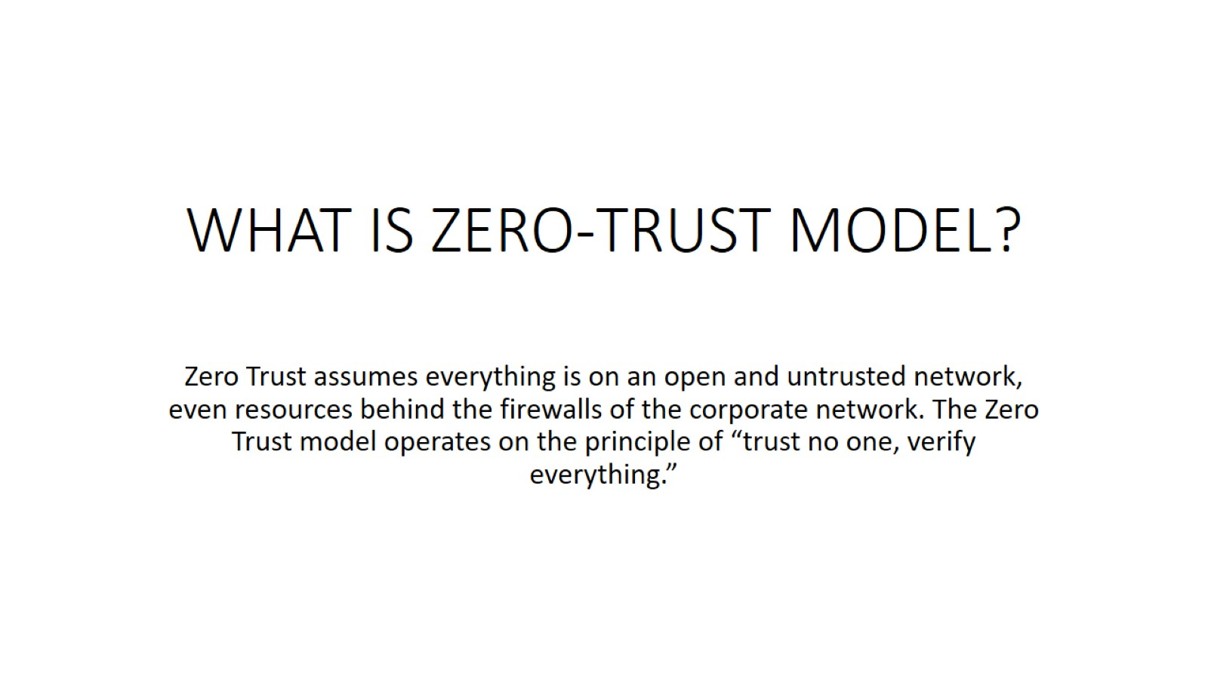
WHAT IS ZERO-TRUST MODEL?

